Slide 1
Register Transfer,
Bus and Memory Transfer

Slide 2
Register Transfer Language
Digital Computer System: interconnection of digital hardware module that accomplish a specific information-processing task.
The various modules are interconnected with common data and control paths.
The modules are constructed from digital components as registers, decoders, arithmetic elements and control logic.
Digital Module: Registers + Operations performed on the data stored in registers.
Micro-operations: The operations executed on data stored in registers.

Slide 3
Register Transfer Language
The result of the operation may be:
  replace the previous binary information of a register or
  transferred to another register
Micro-operations: Examples:- shift, count, clear and load.
A counter with parallel load is capable of performing the micro-operations increment and load.
A bidirectional shift register is capable of performing the shift right and shift left micro-operations.

Slide 4
Register Transfer Language
The internal hardware organization of a digital computer is defined by specifying:
    The set of registers it contains and their function.
    The sequence of micro-operations performed on the binary information stored in the registers.
    The control that initiates the sequence of micro-operations
Digital Computer = Registers +
Micro-operations Hardware + Control Functions

Slide 5
Register Transfer Language
Register Transfer Language (RTL) : a symbolic notation used to describe the micro-operation transfers among registers.
    Define symbols for various types of micro-operations
    Describe the hardware that implements these micro-operations

Slide 6
Register Transfer
Computer registers are designated by capital letters (sometimes followed by numerals) to denote the function of the register.
    MAR: Memory Address Register (holds an address for a memory unit)
    PC: Program Counter
    IR: Instruction Register
    SR: Status Register
    R1: Processor Register

Slide 7

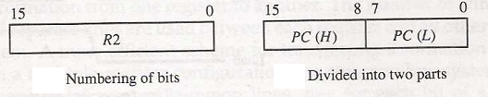
Register Transfer
The individual flip-flops in an n-bit register are numbered in sequence from 0 to n-1 (from the right position toward the left position).
Most common way to represent a register is by a rectangular box.
A 16 bit register can be partitioned into two parts, low bytes and high byte.
Fig: A block diagram of a register

Slide 8
Register Transfer
Information transfer from one register to another is described by a replacement operator: R2 ← R1
This statement denotes a transfer of the content of register R1 into register R2.
The transfer happens in one clock cycle.
The content of the R1 (source) does not change.
The content of the R2 (destination) will be lost and replaced by the new data transferred from R1.
We are assuming that the circuits are available from the outputs of the source register to the inputs of the destination register, and that the destination register has a parallel load capability.

Slide 9
Register Transfer
Conditional transfer occurs only under a control condition
if(P=1) then (R2 ← R1)
Representation of a (conditional) transfer
P: R2 ← R1
A binary condition (P equals to 0 or 1) determines when the transfer occurs.
The content of R1 is transferred into R2 only if P is 1.

Slide 10
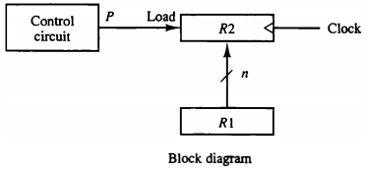
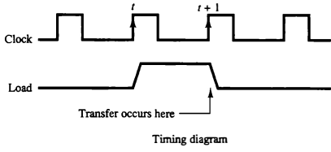
Register Transfer
Hardware implementation of a controlled transfer: P: R2 ← R1

Slide 11
Register Transfer
Basic Symbols for Register Transfers
Symbol | Description | Examples
Letters & numerals | Denotes a register | MAR, R2
Parenthesis ( ) | Denotes a part of a register | R2(0-7), R2(L)
Arrow ← | Denotes transfer of information | R2 ← R1
Comma , | Separates two micro-operations | R2 ← R1, R1 ← R2

Slide 12
Bus and Memory Transfers
A typical digital computer has many registers and paths must be provided to transfer information from one register to another.
The number of wires will be excessive if separate lines are used between each register and all other registers in the system.
Common Bus System is a scheme for transferring information between registers in a multiple-register configuration.
Bus: set of common lines, one for each bit of a register, through which binary information is transferred one at a time.
Control signals determine which register is selected by the bus during each particular register transfer.

Slide 13
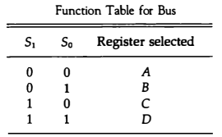
Bus and Memory Transfers
One way of constructing a common bus system is with multiplexers.
The multiplexers select the source register whose binary information is then placed on the bus.

Slide 14
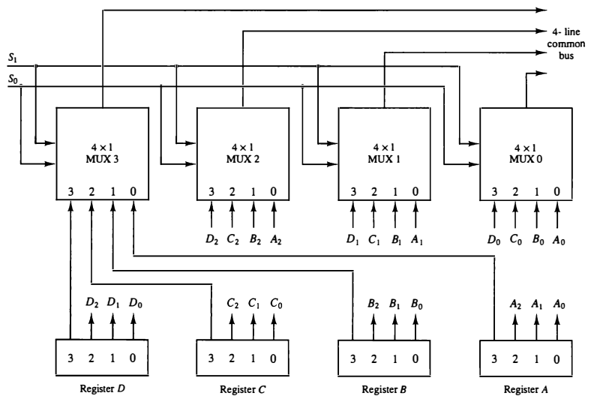
Bus system for four registers

Slide 15
Bus and Memory Transfers
Construction of a bus system for four registers (Example)
Each register has four bits, numbered 0 through 3.
The bus consists of four 4 × 1 multiplexers and two selection inputs, S₁ and S₀.
Both the selection lines are connected to the selection inputs of all four multiplexers.
The selection lines choose the four bits of one register and transfer them into the four-line common bus.

Slide 16
Bus and Memory Transfers
In general, a bus system will multiplex k registers of n bits each to produce an n-line common bus.
The number of multiplexers needed to construct the bus is equal to n, the number of bits in each register.
The size of each multiplexer must be k x 1 since it multiplexes k data lines.
For example, a common bus for eight registers of 16 bits each requires 16 multiplexers, one for each line in the bus.
Each multiplexer must have 8 data input lines and 3 selection lines to multiplex one significant bit in 8 registers.
  no. of the Registers = no. of I/P lines in Mux
  size of the Register= no. of Mux = no. of bus lines

Slide 17
Bus and Memory Transfers
A common bus system can be constructed with three-state gates instead of multiplexers.

Slide 18

Bus and Memory Transfers:
Three-State Bus Buffers
A bus system can be constructed with three-state buffer gates instead of multiplexers
A three-state buffer is a digital circuit that exhibits three states:
logic-0,
logic-1, and
high-impedance (Hi-Z)

Slide 19
Bus and Memory Transfers:
Three-State Bus Buffers
Tri-state buffer has both a normal input and a control input.
The high-impedance state behaves like an open circuit, which means that the output is disconnected and does not have a logic significance.
C=1
Buffer
A
B
A
B
C=0
Open Circuit
A
B
A
B

Slide 20
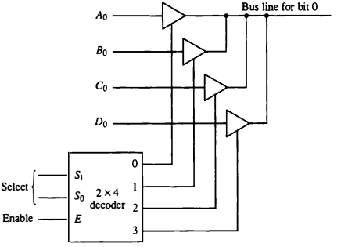
Bus and Memory Transfers:
Three-State Bus Buffers

Slide 21
Bus and Memory Transfers:
Three-State Bus Buffers
The outputs of four buffers are connected together to form a single bus line.
When the enable input of decoder is 0, all of its four outputs are 0, all of its four outputs are 0, and bus line is in a high-impedance state because all four buffers are disabled.
When the enable input is active, one of the three-state buffers will be active, depending on the select inputs of the decoder.
Three-state gates may perform any conventional logic, such as AND or NAND.

Slide 22
Bus and Memory Transfers:
Memory Transfer
Memory read : Transfer from memory
Memory write : Transfer to memory
A memory word will be symbolized by the letter M.
It is necessary to specify the address of M when writing /reading memory
This is done by enclosing the address in square brackets following the letter M
Example: M[0016] : the memory contents at address 0x0016

Slide 23
Bus and Memory Transfers:
Memory Transfer
Assume that the address of a memory unit is stored in a register called the Address Register AR
Lets represent a Data Register with DR.
Transfer of information into DR from the memory word M selected by the address in AR .
    Read: DR ← M[AR]
Transfer of information from DR into the memory word M selected by the address in AR .
    Write: M[AR] ← DR

